Slide 1

Team Parents Meeting
West Springfield Little League
2023

Slide 2
Agenda
Responsibilities
Communication is Key
Relationship with Sponsors
Team Parent Toolbox
Team Banner
Upcoming Dates
Uniforms
Field Prep and Scoreboard
Team Expenses
Party Time
Awards
Parents Guide to Sports Connect and Game Changer Team Manager
Thank You and Contact Information

Slide 3
Responsibilities
Coordinate with team manager
Be a liaison between manager/coaches and the other team families
Know your tools
  Sports Connect, Game Changer Team Manager and SignUp Genius
Know who your team sponsor is and help reach out to them throughout the season
Team banner
Collect money for team related expenses
End of season team party

Slide 4
Communication is key

Slide 5
Communication with team manager
Team parents' job is to take tasks from the manager so they can focus on the players
All managers are different and have different expectations, talk with yours about areas you can help
Areas you can help
  Offer to input practice and game schedules into Sports Connect
  Constantly monitor for game/practice changes or conflicts and adjust/discuss with manager (these may be due to weather or league schedule changes, etc.)
  Send out notices to the team about schedule changes, reminders (dates, equipment, water bottles)
  Sponsor relations

Slide 6
Communication with the team
Send notices about schedule changes and equipment reminders
Create and distribute SignUp Genius for field prep.
  Parents need to help so managers and coaches can stay focused on the kids.
If field prep slots are open, work with other parents to fill the holes
Help recruit other parents of players on your team for other team volunteer slots such as
  score keeper,
  team photographer,
  first aid kit supervisor,
  practice coaches.
Remind volunteers to register

Slide 7
Relationship with Sponsors

Slide 8
Sponsors
Sponsors contributions go to paying for the team uniforms, ball and other fees.
Sponsors should not be asked to pay for anything else since their sponsorship covers the above.
If sponsors offer something it is ok to accept.

Slide 9
Communication with team sponsor
This is one of the most important items for a team parent!
Be sure you and/or your manager introduce yourself to your team sponsor
Ask the Sponsorship Chair for the logo and if they don’t have it reach out to the sponsor directly (you will need this for the banner)
Provide game and practice schedule

Slide 10
Communication with team sponsor
Throughout the season you should be updating your sponsor about the team, invite them to practices, games, opening ceremonies and closing ceremonies
Teams will be provided a team photograph and plaque for the team sponsor to display. Be sure to get this to your sponsor. Your manager should receive this as part of the team photo order for your team.
You could coordinate with your sponsor to throw out a first pitch at a game
Take pictures with your sponsor and the team – we need these for the yearbook
  If your team has the opportunity to visit the sponsor with uniforms on, take a picture in front of the sponsor sign, with the sponsor at their business, etc so we can use these in the yearbook too

Slide 11
Team parent toolbox

Slide 12

Team parent toolbox
Sports Connect
Game Changer Team Manager
SignUp Genius
  Create and distribute SignUp Genius for field prep
  If field prep slots are open, work with other parents to fill the holes

Slide 13
Team Banner

Slide 14
Why is a banner important?
Teams carry banners when they participate in the parade of teams during the opening ceremony
It instills pride in the players - Kids like to see their names
Banners serve as an advertising tool for sponsors

Slide 15
Items to include on the team banner
League Name: West Springfield Little League
Level of Team: Majors, AAA, AA, A, 5-T, or T-Ball
Year: current year
Players names
Players jersey numbers
  Majors will have their jersey numbers
  All levels below Majors do not receive their jersey numbers until after you receive the uniforms and distribute them out to the players, check with managers about number assignment. It may be that you do not have the jersey numbers for the banner printing and that is ok.
Sponsor logo
Sponsor information: Ideally both sponsor telephone number and web address should be included. Minimum of sponsor web address.
Manager’s name
Coaches name(s)
Team parent(s) (optional)

Slide 16
Team Uniform Numbers for Banners
All levels below Majors do not receive their Jersey numbers until after managers receive the uniforms and distribute them out to the players; therefore, your banner will not likely have numbers associated to the players. The uniforms usually come out the week before Opening Day so it would most likely be too close.
Jersey numbers for Majors can be obtained by the coach of the team.
    For more information on uniforms see the Spring Uniforms slide

Slide 17
What to do with the team banner
Bring team banner to each game and hang on your team’s dug out
Remember to take banner down after each game
If you can’t be there, coordinate to have someone else do this
Banners need to be up, part of sponsorship agreement is the sponsor logo, etc are on the banner and it is displayed at the games
You do not need to display the banner at practices

Slide 18
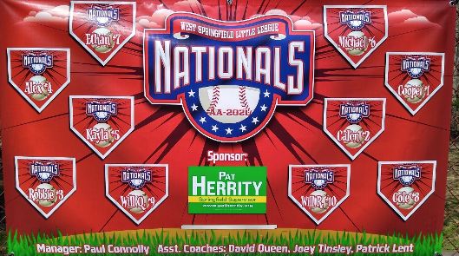
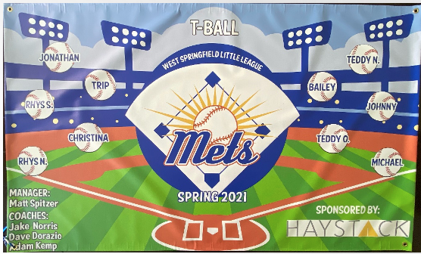
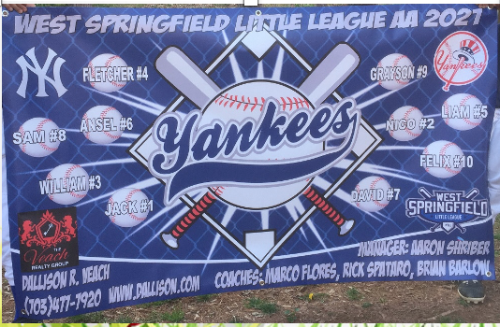
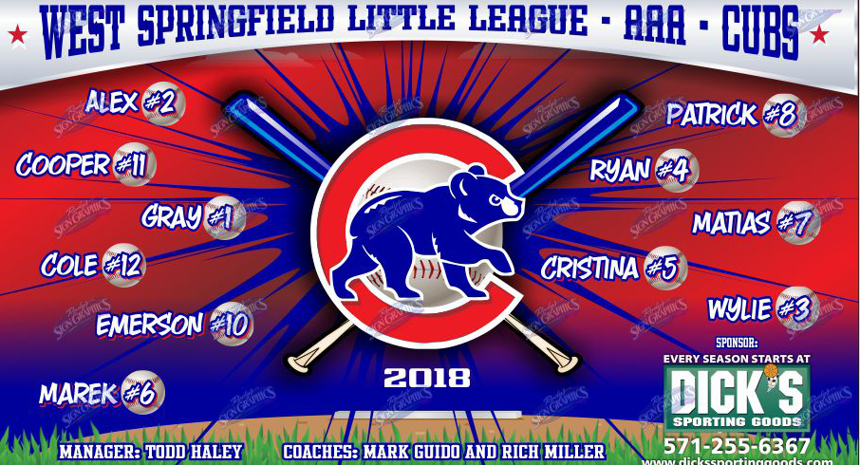
Sample Banners

Slide 19
Where to get the Banner?
Team Banners 4U
https://teambanners4u.com/
Burke Sporting Goods https://www.burkesports.com/
Team Sport Banners http://teamsportbanners.com/
Ask about shipping charges
You may use another vendor of your choice
3' x 5' Standard banner size

Slide 20
Costs Associated to Team Banner
Will the league reimburse the team parent for the banner cost? The answer is No.
Regarding the banners, the cost is shared across the team families. Cash, Venmo or PayPal, its up to you how you would like to receive funds from your team families
The banner cost is not to be incurred by the sponsor. The team families go in on the cost of the team banner. Sponsorships pay for team uniforms, balls and other fees.

Slide 21
Upcoming Dates

Slide 22
Upcoming Dates
Season games for Majors and AAA begin
  Week of March 20, 2023
Opening Ceremony
  Friday, April 14, 2023
Picture Day
  TBD (details to come)
Nationals Park for Youth Baseball & Softball Day
  May 21, 2023 @ 1:35 pm
  Nationals vs Detroit Tigers
Playoffs begin May 22, 2023
Championship Saturday & Closing Ceremony
  June 3, 2023

Slide 23
Uniforms

Slide 24
Spring Uniforms
Spring uniform pickup for IM, Majors and AAA
  Wednesday, March 15, 2023 from 6-7 pm
All other uniform pickups
  Saturday, March 18, 2023 from 10-11 am
Uniform items that are provided by the league:
  Majors players pick their own numbers. All other levels are given numbers 1-12, with sizes corresponding to sizes that parents gave when they registered.
  IM players will receive custom jerseys with their name and number on the back
  IM/Majors/AAA/AA – players will receive jersey and hat
    Parents are responsible for purchasing gray pants for the season for Majors and IM
    Parents are responsible for purchasing white pants for the season for AAA and AA
  1A/T-Ball/5T – players will receive a jersey, white pants, hat, and socks.
  Managers/CORs – the manager and CORs will be provided a hat.

Slide 25
Spring Uniforms (continued)
Check the uniforms ASAP for spelling of team sponsor name and any other issues so it can be addressed before the 1st games (if possible).
You will be provided a printout at distribution that gives the jersey and pant size by player so you will be able to hand everything out easily. An outline of everything that is included in the uniform bags will be provided as well.
For uniform questions contact
Karyn Schneider, Uniform Manager
schneids3@hotmail.com

Slide 26
Field Prep and Scoreboard

Slide 27
Field Prep
What fields are prepped?
  Byron and Fenway fields
What is field prep?
  Before games, this includes raking the infields, lining the batter's box and baselines, 1A level visiting team sets up pitching machine
  Before practices, raking field, base paths, etc

Slide 28
Field Prep
When is field prep done?
  Approximately 1 hour before game begins
Who does field prep?
  Parents of the Home Team (What levels do this?)
  Field Prep must be done by parents not coaches and managers
  Coaches and managers are busy getting the players ready before the games and we don’t want to take away from the kids by having coaches and managers do field prep
Who works the scoreboard?
  Typically, parents of the visiting team
  Instructions for the scoreboard are in the scoreboard boxes
  Scoreboards are operated on Wrigley and Yankee

Slide 29
Team expenses

Slide 30
Team related expenses
Team expenses can include
  End of season team party
  Optional manager and coaches' gifts
  Indoor practice fees (typically for Majors)
Team related expenses are made up of contributions from all players families
Many families prefer if you can come up with a one-time contribution fee so they are not paying multiple times
Extra cost for practice jerseys (if manager decides to have these for the team, more applicable for higher levels) Each player pays for their practice jersey. Team parent may be asked to coordinate the ordering of the practice jerseys.

Slide 31
Party time

Slide 32
End of the season team party
Please check with all of the player’s parents for any dietary restrictions so you are aware when planning
Parties range but most are either
  Held at a restaurant (pre-COVID-19) and occur the same day/weekend after the last game (Pizza is a favorite)
  Typically held at the field immediately following your last game
    These typically involve coordinating having pizza or other food at the field right after the last game
Cake
  Usually there is a cake or cupcakes served after the party. Up to you if you want to do this.
Optional mangers and coaches' gifts from the team presented
  Examples of gifts include gift cards to restaurants or sporting stores,
  signed balls by the team, etc. You may be as creative as you like.

Slide 33
Awards

Slide 34
Awards
The team parent does not have to order awards
Participation trophies/medals are supplied to the Managers for the 5-T, T-Ball, A
First and second - place regular season teams receive trophies for AA, AAA and Majors
Tournament champions and runners-up receive them for A, AA, AAA, and Majors

Slide 35
Sports Connect and Game Changer Team Manager
Matt Waggoner presents

Slide 36


Parents Guide

Slide 37
Overview
League Communications
Using Sports Connect
  Accessing your team page
  Using the team page
  Communications
Using Game Changer Team Manager
  Importing Your Team
  Communications
DO NOT DOWNLOAD THE SPORTS CONNECT APP. IT IS JUST FOR THE SC SOCCOR PROGRAM. BASEBALL USES GAME CHANGER TEAM MANAGER

Slide 38
League Communications
We will send a lot of emails and provide updates on the website, www.wsllbaseball.net , to keep you informed of weather delays, upcoming events, and volunteer opportunities.
Email: If you haven’t received emails from us so far, please check your spam folder and tell your email provider we are not spam.
Texts: We only use texts for weather notifications. You must log into your account and opt into the text program to receive texts.
WSLL will always over communicate weather delays. Please select the option that works best for you

Slide 39
Sports connect

Slide 40
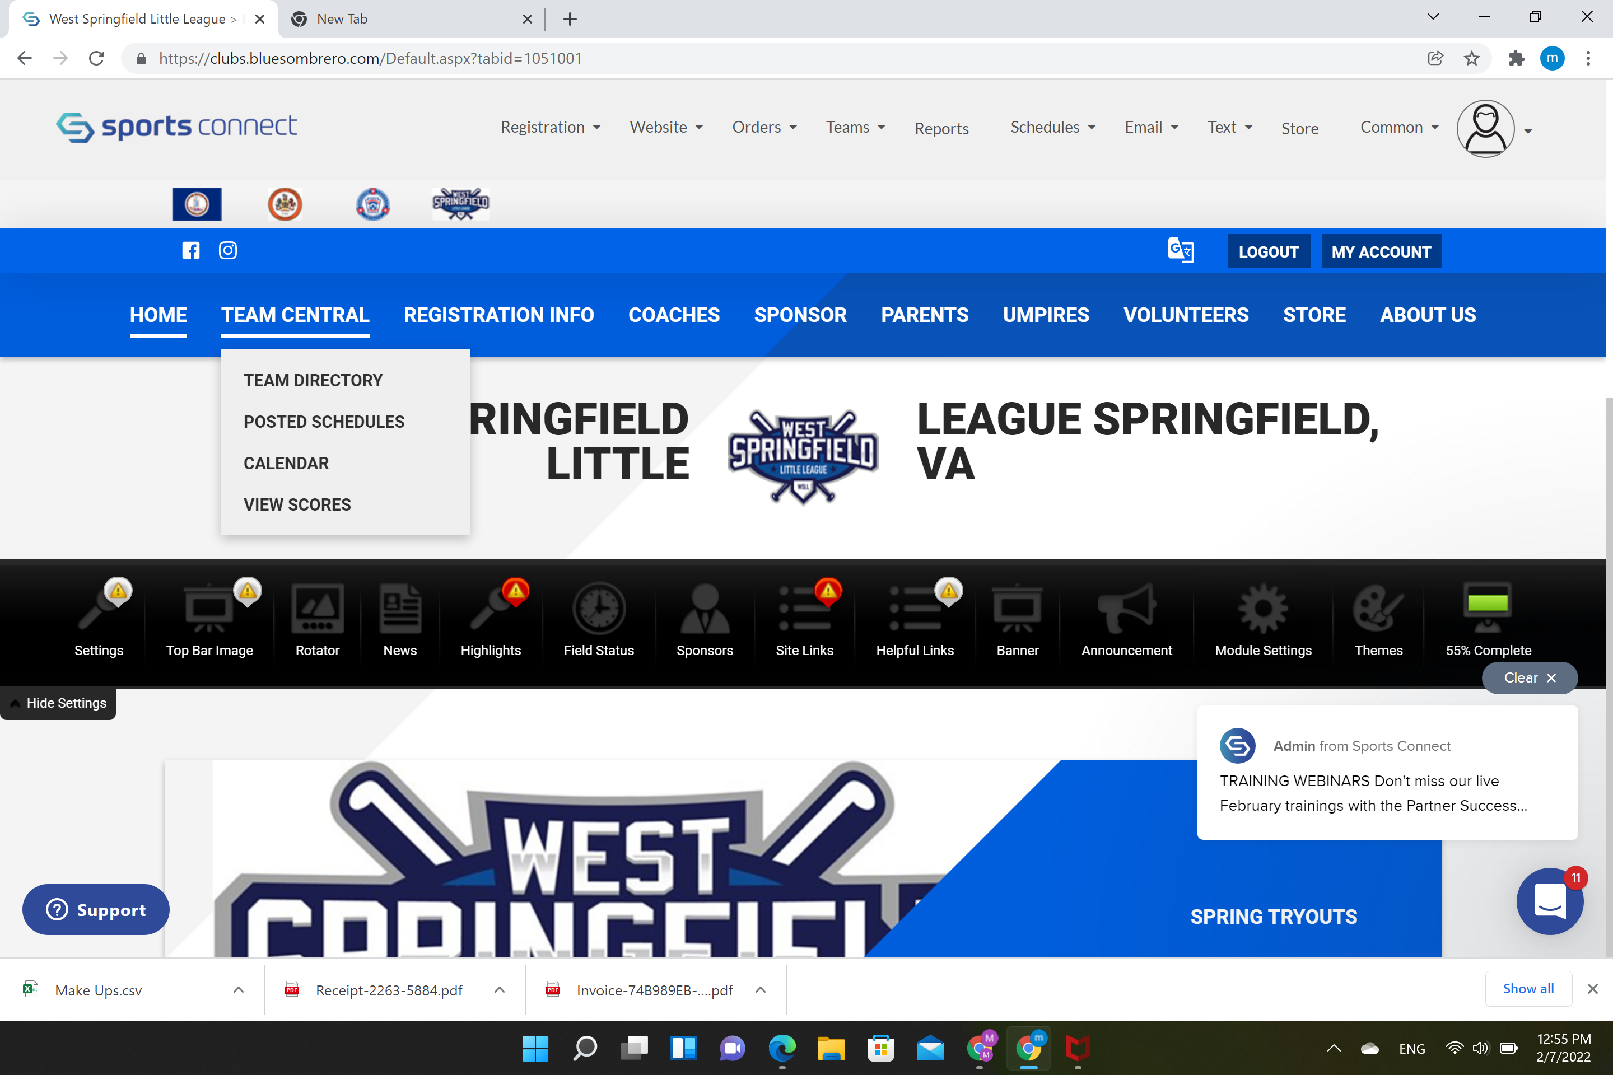
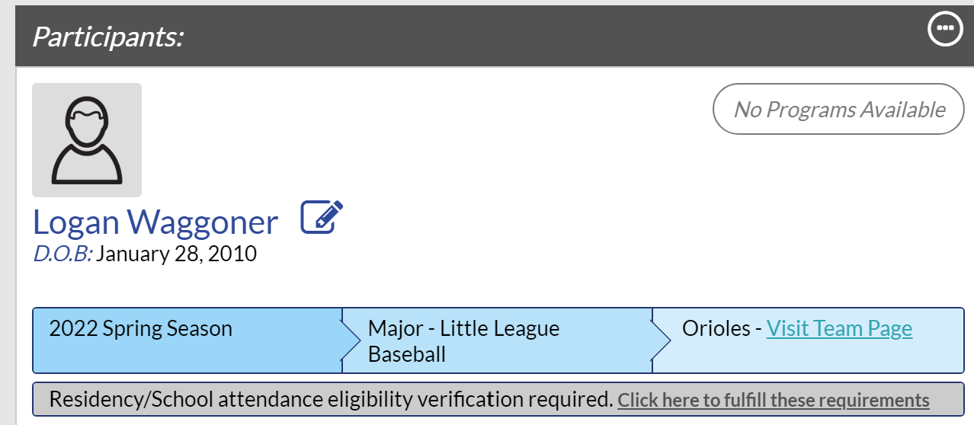
Accessing your Team Page
There are 2 ways to get to the team page
Go to our website, www.wsllbaseball.net
Log into your account.
Stay on the main website
Go to the team central tab and select your team
Log into your account
Select the “visit team page” link in your players participant box.

Slide 41
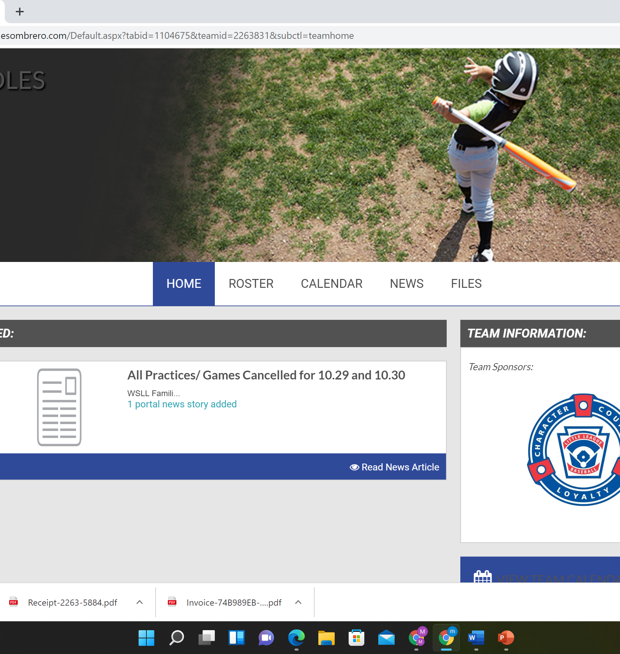
Using the team page
Your one stop shop for all team information.
From the team page, you can see your players, print a roster, see the schedule, email the team, and upload files.
The roster show your players and coaching staff. SC only shows first names on the team page as a safety measure to protect minors under 13.
The file upload feature is handy if you have practice plans, photos, or other documents you need the team to see.
Managers will schedule practices and team events. The league will schedule games.

Slide 42
Communication
Last summer WSLL moved from SI Play to Sports Connect. This was necessary as SI Play was no longer updating their platform and we were losing several key features needed to manage the league.
Email: The email option is located on the team page between News and Files. From here you can select all or some of the players to communicate with, the same as SI Play.
Team app: SI Play offered a team phone app. Sports Connect does not have this feature internal to their platform. The team with Game Changer to provide this service. We will talk more about using this feature in the GC section.
Texts: Team texts are managed from Game Changer Team Manager. This feature is not as smooth as the SI Play texting capability, but it is not a showstopper. We will discuss more about texting in the GC section.

Slide 43
How SC interacts with Game Changer Team Manager

Slide 44
Important Information before use GCTM
The process of using Game Changer Team Manager is not as smooth as SI Play. Go slowly!!
You must also fulfill three requirements before being able to import your team into the app:
  Must use the same login (email address) for Game Changer Team Manager that you use for Sports Connect
  Your team's roster is "posted" to the Sports Connect website.
  You are listed as an allocated volunteer for your team on the Sports Connect site.
Download the Game Changer Team Manager app from the App Store (iOS) or Google Play (Android).
You can only import your team from Sports Connect to Game Changer Team Manager one time.
  Schedule or roster updates will occur automatically to the Game Changer Team Manager app.
  However, events that are listed as "Rescheduled" or "Postponed" on Sports Connect will not appear in Game Changer Team Manager.

Slide 45
Thank you and contact information

Slide 46



Thank you and contact information
Thank you for volunteering to be the Team Parent! If you have any questions or need further assistance, please contact:
Shelley Haley, Team Parent & Sponsorships, email: sponsorships@wsllbaseball.net
Matt Waggoner, Exec VP & Registrar, email: mwaggoner@wsllbaseball.net
Karyn Schneider, Uniform Manager, email: schneids3@hotmail.com
Jerry Brumbaugh, VP, Fields & Facilities, email: VPfields@wsllbaseball.net
WSLL website: www.wsllbaseball.net

